Slide 1

Revolutionizing Sea Urchin Aquaculture
An Onshore Ulva-Tripneustes gratilla IMTA System

Slide 2

The Problem & The Solution
A paradigm shift from linear waste treatment to circular waste valorization.

Slide 3


A Tale of Two Systems
Conventional MRAS
IMTA System
The conventional Marine Recirculating Aquaculture System (MRAS) is a linear "input-output" model. It is often energy-intensive and produces nutrient-rich effluent (waste).
The Integrated Multi-Trophic Aquaculture (IMTA) system is a circular "waste valorization" model. It mimics natural ecology to recover resources and create a self-sustaining loop.

Slide 4
Core Benefits
Environmental and Biological Advantages

Slide 5






A Trifecta of Advantages
Efficient Biofiltration
On-Site Feed Production
Enhanced Urchin Health
Ulva acts as a natural biofilter, removing 100% of Total Ammonia Nitrogen (TAN) and protecting coastal environments.
It closes the nutrient loop. Urchin waste feeds the Ulva, which becomes a sustainable, high-protein feed for the urchins.
Superior water quality reduces stress, avoids ammonia toxicity, and enhances both growth and valuable gonad production.

Slide 6

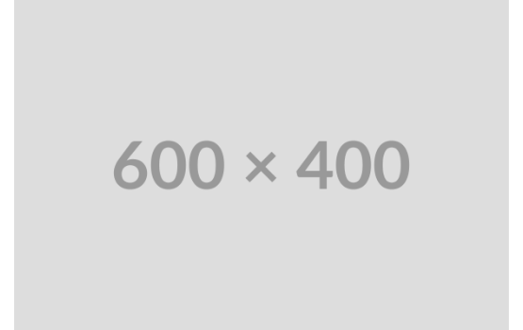
The "Waste-to-Feed" Loop
The IMTA philosophy redefines "waste" as a valuable resource. Ulva cultivated in this nutrient-rich effluent exhibits significantly enhanced protein content, often exceeding 25% dry weight.
This process converts "waste" nitrogen directly into a superior, palatable, and cost-effective feed for the cultured urchins.

Slide 7

The Star Player: T. gratilla
The IMTA system creates a stable, favorable environment, free from the stress of ammonia toxicity common in other systems.
This leads directly to healthier, more resilient urchins with enhanced growth and, most importantly, significant gonad production—the primary marketable product.

Slide 8
Critical Challenges
And Strategies for Optimization

Slide 9
The Nitrogen Bottleneck
The Bottleneck
The Opportunity
A critical limitation: dissolved ammonia (TAN) from the urchins is *insufficient* to grow all the Ulva biomass needed for a 100% on-site feed loop.
The bulk of nitrogen is locked in particulate waste (sludge). The key is efficient *mineralization* of this sludge into bioavailable forms (ammonia, nitrate) that the Ulva can consume.

Slide 10






Co-Benefits & Smart Management
CO2 Mitigation
Smart Management
Future Technology
Ulva's photosynthesis actively consumes dissolved CO2, buffering the pH and protecting urchins from acidification.
Operational success relies on key strategies: optimal stocking (20% coverage) and shallow baskets (10cm) for feed access.
Open-source computer vision is being developed for faster, non-stressful measurement of urchin test diameter and growth.

Slide 11
The System in a Nutshell
The IMTA system is like a self-watering garden. The urchin 'waste' water is directed to the Ulva (the filter), which grows into nutritious feed that is fed back to the urchins, completing the circle.
"
"
— Analogy from Research Summary

Slide 12
Thank You
Questions?

